Slide 1

Few Topics in Exotics and
Heavy Ion Collision
Su Houng Lee
Where are the compact flavor Exotic states?
What can we learn from Exotic production in heavy ion collision
Anowledgements:
Quark Model: Woosung Park, Aaron Park, Sungtae Cho, Sungsik Noh,
Exotics in Heavy Ion:

Slide 2
Few words on “Multiquark states”

Slide 3

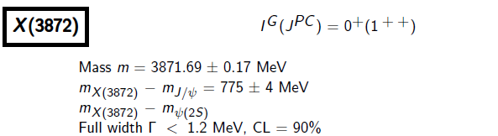


X(3872)
- 2003 -
→ more X,Y, Z states
Pentaquark - Pc
- 2015 -

Slide 4
Baryon with ccu
PRL119 (2017)112001
- 2017 -
d*(2380)
- WASA-at-COSY [H. Clement]-

Slide 5
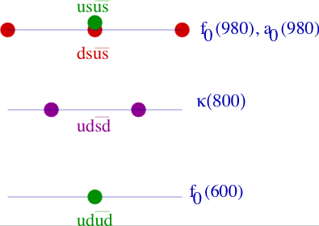
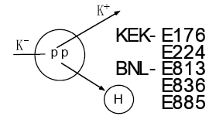
Revival of an old topic
☞ Tetraquark: (Crypto-exotic)
scalar tetraquark (Jaffe 76)
→ not easy to prove
☞ Dibaryon: (Flavor-exotic)
H (ududss) dibaryon (Jaffe 77):
→ experimentally not found
☞ Pentaquark: (Flavor-exotic)
Pcs (Gignoux, Silvestre-Brac, Richard 87)
Pcs (udusc) (Lipkin 87)
→ Fermilab E791 : not found
u
u
c
d
s

Slide 6
Normal meson, compact multiquark, molecules, resonances
 | Normal meson | Compact multiquark | Molecules | Resonance
Geometrical configuration
Examples | Nucleon, pion, kaon | Flavor exotic? | X(3872) | K*, ρ meson
u
u
d
u
u
c
c
d
d
u
u
d
d
d
Are Pc, X, d* compact or loosely bound molecular states ?
How can we distinguish compact vs molecular states ?
Where are the compact flavor Exotics ?

Slide 7
II: Where are the compact “Multiquark states”
Compact configuration and nuclear force at short distance

Slide 8
Lattice Results : HAL QCD collaboration for H dibaryon in SU(3) symmetric limit
SU(3) flavor 1 state
SU(3) flavor 27 state
→ Flavor 1 channel could give compact configuration
Compact multiquark states could exists if there is a strong short range attraction
The r→0 can be understood from quark model → Aaron Park’s talk next week
Notes:
First could give compact configuration, the second may be resonance. So what does give the short distrance behavior ?

Slide 9

Nuclear force at short distance
☞ Long distance force > 0.5 fm → meson exchange
1
2
4
5
3
6
☞ Short distance force < 0.5 fm → quark dynamics
1
2
4
5
3
6
→ Work out quark interaction involving (color) x (spin) x (flavor)

Slide 10
In quark model: wave function should follow Pauli Principle
Totally antisymmetric (color x spin x flavor) wave function (s-wave ground state)
1
2
3
4
5
6
Example: Ω(sss)Ω(sss) in the Spin=3 channel is highly repulsive because
Flavor is totally symmetric
Spin is totally symmetric
Remaining part should be totally antisymmetric
But color singlet implies
Hence, assuming all quarks are in the S wave, Pauli principle forbids compact configuration.
Such forbidden configuration are highly repulsive at r→0 (Oka et al quark cluster model)

Slide 11
Constituent quark model (can fit ground state hadron spectrum)
Color-color (CC) interaction (s-wave quark states)
☞ Sum of 2-body CC int. is proportional to Total number of quarks:
(For color singlet configuration)
1
2
4
5
1
2
4
5
3
6
3
6
→ No strong attraction or repulsion compared to isolated two baryons

Slide 12
Quark 3-body force
Two types
- Note, related to 2 Casimir
→ 3-quark interaction are additive: For color singlet state composed of N_{Total}=N_{B1}+N_{B2} quarks

Slide 13


Effects of intrinsic quark three-body force
$$f^{abc}F_{1}^{a}F_{2}^{b}F_{3}^{c}$$
$$d^{abc}F_{1}^{a}F_{2}^{b}F_{3}^{c}$$
1) Basic notation

Slide 14
f –type intrinsic quark three-body force
$$f^{abc}F_{1}^{a}F_{2}^{b}F_{3}^{c}$$
Consider N₁ quarks and N₂ antiquarks so that N= N₁+N₂ .
we want to calculate , where the subscripts denote “j” quark
Start from
= T₁ + T₁₋₂ + T₁₋₃

Slide 15
f –type intrinsic quark three-body force
$$f^{abc}F_{1}^{a}F_{2}^{b}F_{3}^{c}$$
= T₁ + T₁₋₂ + T₁₋₃
T₁₋₂ =
T₁₋₃ =
Therefore = 0

Slide 16

d –type intrinsic quark three-body force
$$d^{abc}F_{1}^{a}F_{2}^{b}F_{3}^{c}$$
Consider N₁ quarks and N₂ antiquarks so that N= N₁+N₂ .
we want to calculate , where the subscripts denote “j” quark
Start from
= T₂ + T₂₋₂ + T₃₋₃

Slide 17

Effects of intrinsic quark three-body force
$$d^{abc}F_{1}^{a}F_{2}^{b}F_{3}^{c}$$
= T₂ + T₂₋₂ + T₃₋₃
T₂₋₂ should be divided according to quark and antiquarks

Slide 18
Adding all T₂₋₂ =

Slide 19
T₃₋₃ =

Slide 20
Color-spin interaction
☞ Color-spin interaction for 2 body:
Color | A | S | A | S | 1 | 8 | 1 | 8
Flavor | A | A | S | S
Spin | A(1) | S(3) | S(3) | A(1) | 1 | 1 | 3 | 3
K | -8 | -4/3 | 8/3 | 4 | -16 | 2 | 16/3 | -2/3
q
q
q
q
u
d
meson
☞ For N quarks, Color-Spin interaction is NOT proportional to N
Proton
Delta

Slide 21
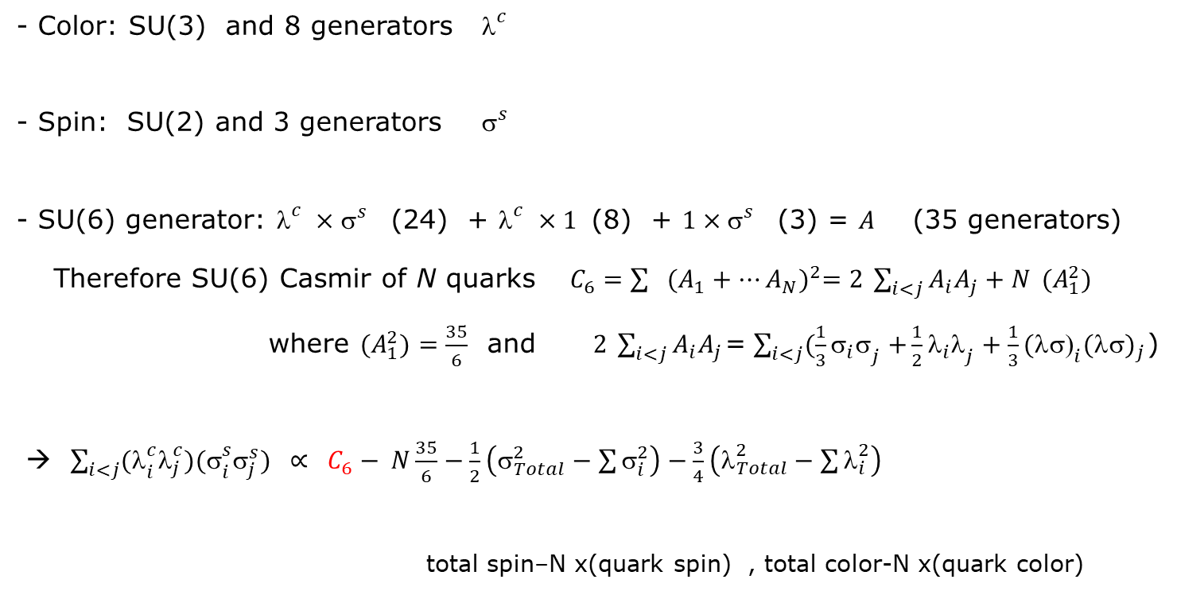
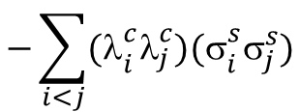
$$−\sum_{i<j}{{\text{(}\text{l}}_{i}^{c}{\text{l}}_{j}^{c}){\text{(}\text{s}}_{i}^{s}{\text{s}}_{j}^{s})}$$
Color spin interaction - General remarks
1) Part of a larger group
- Color: SU(3) and 8 generators${\text{l}}_{}^{c}$
- Spin: SU(2) and 3 generators ${\text{s}}_{}^{s}$
- SU(6) generator: ${\text{l}}_{}^{c}×{\text{s}}_{}^{s}$ (24) + ${\text{l}}_{}^{c}×1$ (8) + $1×{\text{s}}_{}^{s}$ (3) = $A$ (35 generators)
Therefore SU(6) Casmir of N quarks $C_{6}={\sum{{(A_{1}+…A_{N})}^{2}=2 \sum_{i<j}{A_{i}A_{j}}+N }{(A}_{1}^{2}) }^{}$
where ${(A}_{1}^{2})=\frac{35}{6}$ and $2 \sum_{i<j}{A_{i}A_{j}}$=$\sum_{i<j}{(\frac{1}{3}{{\text{s}}_{i}\text{s}}_{j}+}\frac{1}{2}{{\text{l}}_{i}\text{l}}_{j}+\frac{1}{3}{{\text{(}\text{ls}\text{)}}_{i}(\text{ls})}_{j}$)
→ $\sum_{i<j}{{\text{(}\text{l}}_{i}^{c}{\text{l}}_{j}^{c}){\text{(}\text{s}}_{i}^{s}{\text{s}}_{j}^{s})}$ $∝ C_{6}− N\frac{35}{6}−\frac{1}{2}\left({\text{s}}_{Total}^{2}−\sum{{\text{s}}_{i}^{2}}\right)−\frac{3}{4}\left({\text{l}}_{Total}^{2}−\sum{{\text{l}}_{i}^{2}}\right)$
total spin–N x(quark spin) , total color-N x(quark color)

Slide 22

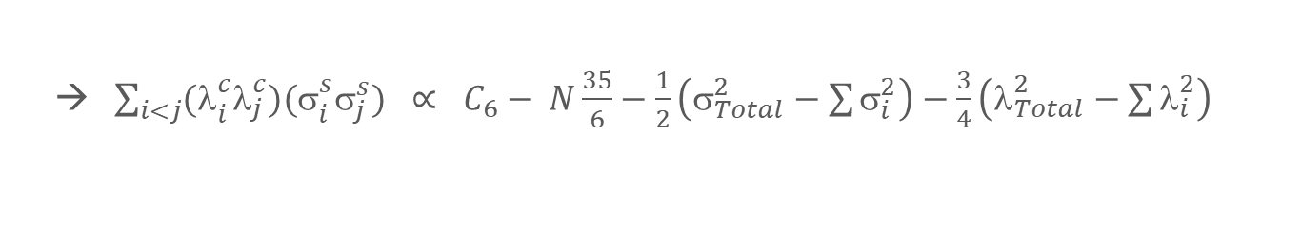
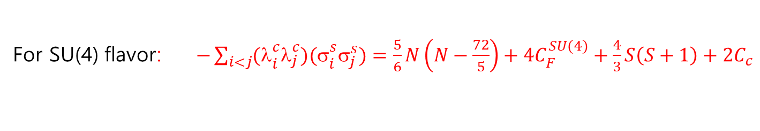
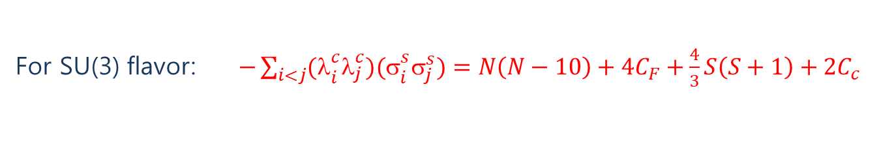
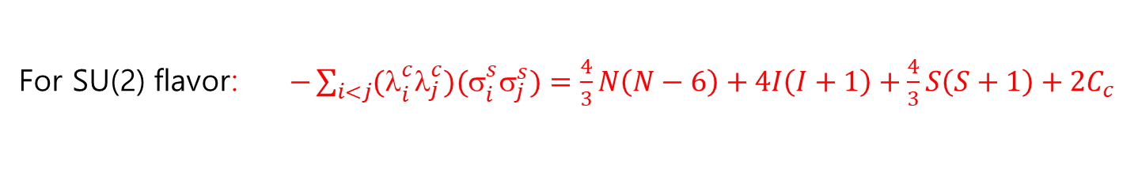
Color spin interaction - General remarks II
→ $\sum_{i<j}{{\text{(}\text{l}}_{i}^{c}{\text{l}}_{j}^{c}){\text{(}\text{s}}_{i}^{s}{\text{s}}_{j}^{s})}$ $∝ C_{6}− N\frac{35}{6}−\frac{1}{2}\left({\text{s}}_{Total}^{2}−\sum{{\text{s}}_{i}^{2}}\right)−\frac{3}{4}\left({\text{l}}_{Total}^{2}−\sum{{\text{l}}_{i}^{2}}\right)$
2) Color –flavor-spin wave function should be totally antisymmetric. Then
For SU(2) flavor: $−\sum_{i<j}{{\text{(}\text{l}}_{i}^{c}{\text{l}}_{j}^{c}){\text{(}\text{s}}_{i}^{s}{\text{s}}_{j}^{s})}=\frac{4}{3}N\left(N−6\right)+4I\left(I+1\right)+\frac{4}{3}S\left(S+1\right)+2C_{c}$
For SU(3) flavor: $−\sum_{i<j}{{\text{(}\text{l}}_{i}^{c}{\text{l}}_{j}^{c}){\text{(}\text{s}}_{i}^{s}{\text{s}}_{j}^{s})}=N\left(N−10\right)+4C_{F}+\frac{4}{3}S\left(S+1\right)+2C_{c}$
4$C_{F}=\frac{4}{3}\left(p^{2}+q^{2}+3p+3q+qp\right)$
q p using $p+2q=N$ → 4$C_{F}=\left(4I\left(I+1\right)+N(N+6)/3\right)$
For SU(4) flavor: $−\sum_{i<j}{{\text{(}\text{l}}_{i}^{c}{\text{l}}_{j}^{c}){\text{(}\text{s}}_{i}^{s}{\text{s}}_{j}^{s})}=\frac{5}{6}N\left(N−\frac{72}{5}\right)+4C_{F}^{SU(4)}+\frac{4}{3}S\left(S+1\right)+2C_{c}$

Slide 23
☞ Color-Spin interaction for N quarks in terms of flavor (Aerts, Mulders, de Swart 78)
Diquark (ud)
u
d
H (ududss)
u
d
u
d
u
s
d
s
s
s
d
u
Pcs (udusc)
u
u
u
d
c
c
d
s
u
s

Slide 24
Comparison with lattice (HAL QCD) – NN interaction
☞ NN force in SU(2) spin 1 vs spin 0 channel (W.Park, A. Park, Lee 2015)
→ comparison
☞ H dibaryon channel: Flavor 1 vs Flavor 27

Slide 25
But why no H dibaryon? Flavor breaking effect in color-spin interaction
Need to Work out (color) x (spin) x (flavor) wave function (W. Park, A. Park, Cho, Lee)
☞ H dibaryon channel: Flavor Breaking effect weakens attraction in Flavor 1
H
Λ
Λ
u
s
d
vs
u
s
u
d
s
d
u
d
s
 | H dibaryon | Λ + Λ | Δ E_{CS} | Δ E_{kin}
 |  |  | -145 MeV | +100 MeV
 |  |  | -61 MeV | +100 MeV
25

Slide 26
Flavor breaking effect in other channels
☞ Pentaquark Pcs (udusc) (Lipkin 87): weakened from symmetric case
→ Marginal: probably Not strongly bound
☞ Pentaquark Pc (uudcc) (LHCb)
Can not be a compact state (Park,Park,Cho, Lee PRD95(17))
→ probably molecular type
☞ Dibaryon d*(2380) (uuuuuu) (WASA at COSY)
Can not be a compact state (Park,Park,Lee PRD92(15))
→ probably molecular type

Slide 27
Color spin interaction - Pentaquark -1
H. Lipkin, PLB 195 (1987) 484
1) 4 light quark and 1 Heavy anti-quark
u
u
c
d
s

Slide 28
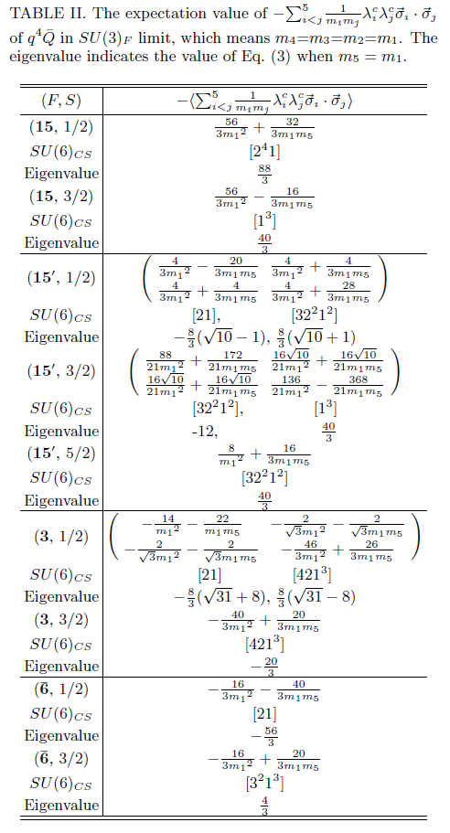
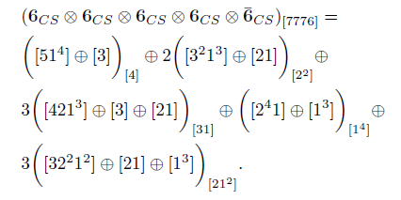
Color spin interaction - Pentaquark
W. Park, Sungtae Cho, SHL, arXiv:1811.10911
1) 4 quark and 1 heavy antiquark state
Flavour
Color-Spin

Slide 29
Where are the compact Flavor exotics? (W.Park, S. Cho, Lee arXiv:1811.1091)
☞ With flavor breaking
Most attractive →

Slide 30
Most probable Pentaquark P_{cc} (udccs) (W.Park, S. Cho, Lee arXiv:1811.1091)
☞ Color spin configuration q⁴ : SU(6) [31] and Spin=0 → K=-16
Responsible for (Gignoux, Silvestre-Brac, Richard 87) (Lipkin 87)
But with flavor breaking, has the largest color spin attraction
☞
☞ has similar decay mode as the LHCb
Alice ?
LHCb ?

Slide 31
Most probable Tetraquark T_{bb} T_{cc} (udcc)
☞ Heavy quark-antiquark
c
u
c
d
☞ Heavy quark-quark
c
c
u
d

Slide 32
III: Exotica production from Heavy Ion Collision

Slide 33
Particle production in heavy ion collision
Hadron
Compact Multiquark
formation
Light nuclei
Molecular structure formation
T
T_{C}
T_{μ}
T_{F}
τ
QGP
Hadron phase
1 fm/c
5 fm/c
7 fm/c
17 fm/c

Slide 34


Production of compact multiquark state (ExHIC PPNP 2017)
Model central rapidity, central collision using Lattice EOS
Heavy quark production (T Song)
Coalescence Parameters:
fit production of normal hadrons
from statistical model

Slide 35
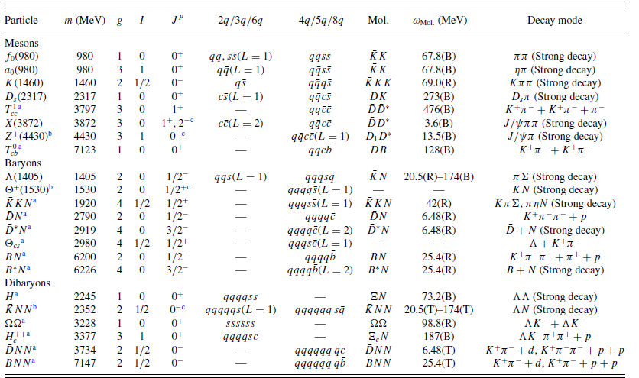
Hadron coalescence for molecules at kinetic freezeout point

Slide 36
Production of compact multiquark state
Production rate normalized to statistical model
Normal Hadron
Molecule
Compact multiquark
PRL 106(2011)212001, PPNP95(2017)279

Slide 37
Summary
☞ Most probable Flavor exotic compact Pentaquark state: P_{cc}
☞ Most probable tetraquark state: T_{bb} or T_{cc}
☞ Recently discovered Multiquark states D*,Pc, X(3871), Z are most likely molecular states
☞ Future: Pt dependence → Sungtae Cho
Hadronic effects→ Juhee Hong

